Slide 1
2020 Annual Report Sedgwick County Suicide Prevention Coalition

Slide 2
Thank You!
Sedgwick County Health Department
Kaylee Hervey
Sedgwick County Regional Forensic Science Center
24/7 Suicide Prevention Hotline
316-660-7500

Slide 3
2020 Suicide Rate
105 suicide deaths in Sedgwick County.
20.4 suicide deaths per 100,000 Sedgwick County residents.
24/7 Suicide Prevention Hotline
316-660-7500
Notes:
Increase from previous year, but is more in-line with previous years (2019 had 94 deaths (18.3 rate), but 2018 had 101 deaths and rate of 19.7)

Slide 4
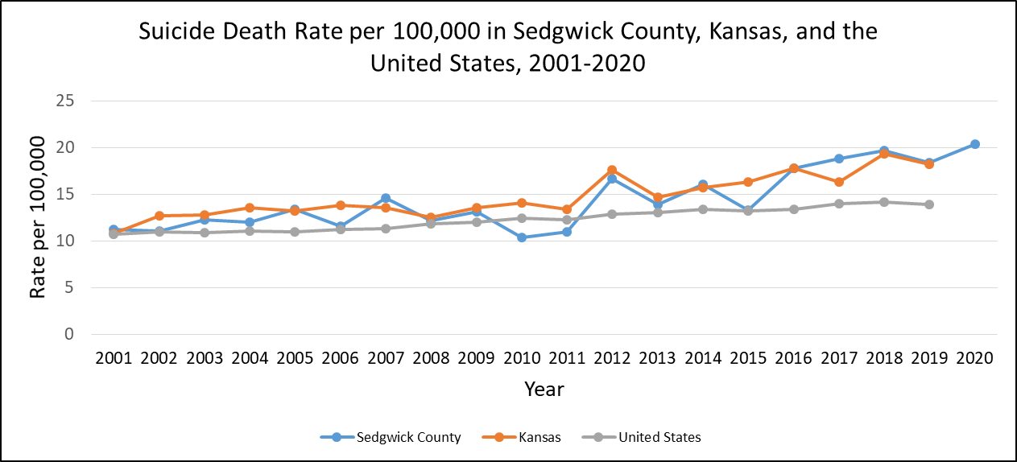
Comparisons with State and National Rates
24/7 Suicide Prevention Hotline
316-660-7500

Slide 5
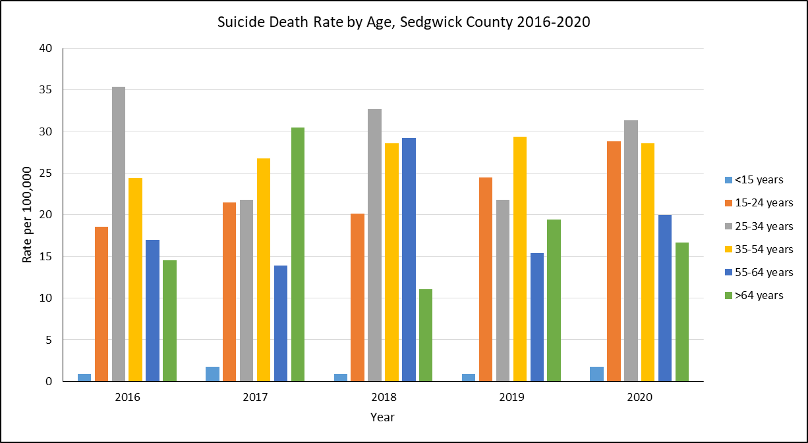
Suicide Rates per 100,000 by Age
24/7 Suicide Prevention Hotline
316-660-7500
Notes:
In 2020, we saw the highest rate of suicide in the 15-24 year old age group that we’ve seen since we started tracking these data (28.78 in 2020 compared to 28.6 per 100,000 in the 2012 spike). There were twice as many deaths among 10-24 year olds as 15-19 year olds.

Slide 6
Suicide Rates per 100,000 by Gender
24/7 Suicide Prevention Hotline
316-660-7500
Notes:
Similar to previous years, males made up the majority of suicide deaths in Sedgwick County at 90%. Females constituted only 10% of suicide deaths. (Usually closer to 75/25)

Slide 7
Suicide Rates per 100,000 by Method
24/7 Suicide Prevention Hotline
316-660-7500
Notes:
Firearms continue to the most common method of suicide at 50% of cases, followed by hanging/asphyxiation at 31%, then by drug overdose/poisoning at 15% of cases. This is our highest rate of firearm deaths, consistent with the increasing trend we’ve seen over several years.

Slide 8
Preliminary 2021 Data by Month
*2021 data is preliminary and may change
24/7 Suicide Prevention Hotline
316-660-7500
Notes:
As of June, 37 suicide deaths have occurred in 2021 (this is similar to 2019, which was a lower year). In 2020, there were 49 in the first half of the year.

Slide 9
Mental Health and Suicide History
55 percent of deaths had known history of mental illness
Depression was the most commonly noted mental illness
Anxiety was the second most common
54 percent of deaths had known history of suicidal ideations
18 percent of deaths had known history of previous suicide attempts

Slide 10
Life Stressors by Age
Notes:
Same patterns as seen in previous years
Relationship stressors most common in younger suicides
Physical health stressors most common in older suicides
31% of cases had a history significant for a medical issue
The most common were cardiovascular disease and diabetes
Only 5% of deaths mentioned COVID-19 specifically (1 quarantine, 4 job loss or decreased hours)
Overall numbers of autopsies mentioning job or financial stressors was lower than in past years
13% of deaths were veterans

Slide 11
Local Suicide Prevention Efforts
Mental Health First Aid
104 people trained in MHFA in 2020
Went virtual for the first time, allowed for expanded access
80 trained so far in 2021, 7 more classes scheduled
Zero Suicide implementation
Expanding screening, data tracking, and care collaboration
Building community awareness/leadership, enhancing continuous quality improvement
Trainings in evidence based screening, assessment, and interventions, including QPR, CALM, AMSR, and CAMS
988 expansion efforts underway
Expected to go live in July 2022
Crisis call volume expected to increase
COMCARE will support 988 calls from the Sedgwick County area

Slide 12
Know the Signs
TALK: No reason to live. Feeling trapped. Being a burden to others. Unbearable pain. Talk of killing themselves.
BEHAVIOR: Increased alcohol/drug use. Isolation from family and friends. Sleeping too little/too much. Withdrawing from activities. Seeking access to pills/weapons or other means.
MOOD: Depression. Loss of interest. Rage. Irritability. Humiliation. Anxiety.
24/7 Suicide Prevention Hotline
316-660-7500

Slide 13
What can you do?
Take it seriously, if someone mentions suicide.
Talk openly and matter-of-factly about suicide.
Be willing to listen. Allow expressions of feelings. Accept the feelings.
Offer hope that help is available.
Do not leave him or her alone.
Get help immediately!
24/7 Suicide Prevention Hotline
316-660-7500

Slide 14
Get Involved
Community Health Improvement Plan
Contact Daisey Urbina-Ceja Daisy.Urbina-Ceja@sedgwick.gov
Mental Health First Aid classes for youth and adults (virtual)
Sept 17, Oct 15, Nov 5
Contact Tina Prejean 660-7706
https://ichoosetotalk.org/
Party for Prevention
https://5thpartyforprevention.eventbrite.com
Suspenders4Hope Run/Walk
https://suspenders4hope.stopsuicideict.com/
24/7 Suicide Prevention Hotline
316-660-7500
Notes:
Zero Reasons Why coming to SC

