Slide 1
August 19th, 2021
2pm
Ann Houk lepc chair
Call to order at 2pm
Approve/correct November meeting minutes

Slide 2
Mission
The mission of the Sedgwick County Local Emergency Planning Committee (LEPC) shall be to fulfill the requirements of the Superfund Amendments and Reauthorization Act of 1986, commonly known as SARA Title III. In addition, the LEPC shall be an all-hazards planning committee to include: information sharing, community planning, exercise design/implementation, the critique of emergency incidents—real or exercised, other activities aimed at efficient, compassionate, and rapid response to disaster survivors’, care-givers’, and workers’ needs in times of disasters.

Slide 3
Agenda
Agenda Item | Presenter | Role
OLD BUSINESS
Radiological Safety Training | Ann Houk | LEPC Chair
Full Scale Exercise AAR Status | Julie Stimson | SCEM
LEOP Review Status | Julie Stimson | SCEM
Business Recognition Program Status | Tom Bedard Daniel Fenn | Accuweather C3 Safety
SCEM New Staff | Julie Stimson | SCEM
2022 Meeting Dates and Presenters | Ann Houk | LEPC Chair
NEW BUSINESS
ICS Training Level 300/400 | Julie/Ann | SCEM/LEPC
2021 Supplemental Grant LEOP Workshop/Education | Ann Houk Julie Stimson | LEPC Chair SCEM
COVID 19/Influenza Vaccine Clinics | Ann Houk | LEPC Chair

Slide 4
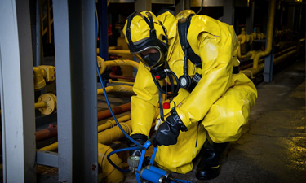
Old Business
Radiological Safety Training
3Fire Fighters completed pre-requisites for attending this training: Micah Fisher, Micah Hoelscher and Jeremiah Toothaker.
Training is paid for and all travel accommodations through State of Kansas (THANK YOU Mark Willis, Training Program Manager/State Training Officer)

Slide 5
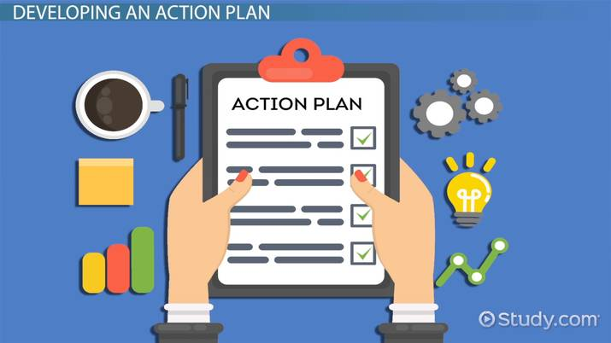
Full Scale Exercise AAR Status
SCEM action plan
WFD action plan
SCEMS action plan

Slide 6
LEOP REVIEW STATUS
The initial base plan has been reviewed and updated by EM
Working with KDEM to get Kyle to host an in-person LEOP workshop here in Wichita
Approval deadline is 12/31/2021.

Slide 7
BUSINESS RECOGNITION PROGRAM
6 Businesses Competing for 2021 Recognition
The Coleman Company
Ardent Mills, David Byers, 316-670-8002, david.byers@ardentmills.com
Smithfield Packaged Meats, Connie Stone, 316-941-0549, cstone@smithfield.com
Andale Ready Mix, robertb@andalereadymix.com
Universal Products, becky.nichols@u-p.com
Wesley Medical Center, Thomas Donnay 316-200-9012 thomas.donnay@wesleymc.com

Slide 8
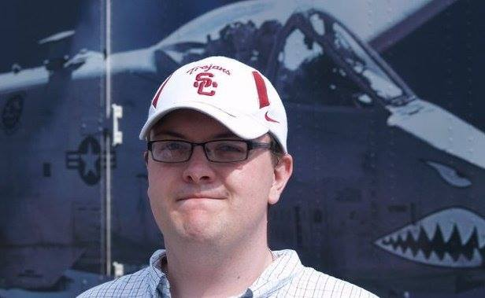
SCEM NEW STAFF
Reagan Bender is the new EM Planner

Slide 9
New Business
ICS Training Level 300/400
On Hold due to re-emergence and rise of COVID 19
Mark Willis to reschedule when restrictions relaxed (we have been given 1st priority)
SPORT EVENT RISK MANAGEMENT
AWR-167: https://my.teex.org/TeexPortal/Default.aspx?MO=mCourseCatalog&D=LS&C=AWR167&S=216
Sport Venue Evacuation and Protective Actions
For MGT-412: https://my.teex.org/TeexPortal/Default.aspx?MO=mCourseCatalog&D=LS&C=MGT412&S=204
Integrated Planning & Preparedness Workshop, tentatively scheduled for Nov 12
2021 SUPPLEMENTAL GRANT
Ann working on supplemental grant of up to $15,000 for specific training.
Swapan identified approved training courses-Ann working with Micah and Pearman to obtain additional training
LEOP Workshop/Education
Julie working on education with Kyle Oneth with KDEM
COVID 19/Influenza Clinics (on site)
Contact Ann Houk if you are interested in offering this at your business

Slide 10
Presentation(s)
David Byers, Ardent Mills
Regional Plant Manager/Operations
715 E 13th St. N, Wichita, Kansas 67214
Ardentmills.com
David.byers@ardentmills.com
Cell: 507-313-3891
Direct: 316-670-8002

Slide 11
Natural Gas Pipeline Explosion Ellsworth Kansas 07/23/2021
https://youtu.be/dUkgtp5sb70
https://youtu.be/FCAfYtafzls
Black Hills Energy
Lon Meyer, Operations Manager
Shane Cornelious, Operations Supervisor
Larry Claycomb, Technical Services Manager

Slide 12
Round Table Discussion
Any communication needs?
Any business relations that we need to reach out to?
Do you have questions about your Emergency Plans?
Do you have questions about Tier II reporting?
Do you have any training needs?

