Slide 1
February 18th, 2021
2pm
Ann Houk lepc chair
Call to order at 2pm
Approve/correct November meeting minutes

Slide 2
Review of Minutes from November 2020
Review of Minutes
Changes to Make

Slide 3
Agenda
Agenda Item | Presenter | Role
OLD BUSINESS
2020 HMEP Grant Update | Ann Houk Haither Zaragoza | LEPC Chair SCEM
PEAC Software | Haither Zaragoza | SCEM
LEOP Review | Haither Zaragoza | SCEM
Hazardous Recognition Program | Tom Bedard Daniel Fenn | Accuweather 3
Open position for LEPC Secretary/Chair | Ann Houk | LEPC Chair
Bylaws/Memberlist | Ann Houk | LEPC Chair
NEW BUSINESS
HMEP Grant 2021 | Haither Zaragoza | SCEM
Full Scale Exercise | Ann Houk | LEPC Chair
Tier II Education | Ann Houk | LEPC Chair
Education | Chance Hayes | NOAA

Slide 4
Old Business
2020 HMEP Grant Update
Supplemental
PPE
Logistics
Functional Exercise Outcomes

Slide 5
PEAC SOFTWARE-ARISTATEK
Sherry Crowe
WWW.ARISTATEK.COM
PEAC-WMD Software provides vital Hazmat and CBRNE information, enabling Hazmat Responders to make informed decisions at the incident. The PEAC Software includes integrated mapping, GPS connectivity, over 100,000 chemical names, synonyms & trade names, multiple modeling tools, and much more! The PEAC Software has been designed as the complete decision support solution for Hazmat Professionals, for use at the scene, when seconds and lives count. The patented PEAC Software is the only application that includes an easy to use toxic or flammable vapor cloud dispersion model integrated with a broad and comprehensive database of toxic industrial chemicals, chemical warfare & biological agents, explosives, and radioactive isotopes. Utilizing the many modeling tools provided, the PEAC System quickly calculates standoff distances and exclusion zones, at the incident and using the actual weather and topography conditions present. All modeling tools allow the Hazmat Responder to deal with the actual Hazmat substances, present container configurations, and the nature of the actual leak or release present.

Slide 6
LEOP REVIEW
In our country's system of emergency management, local government must act first to attend to the public’s emergency needs. Depending on the nature and size of the emergency, State and Federal assistance may be provided to the local jurisdiction. The local EOP focuses on the measures that are essential for protecting the public. These include warning, emergency public information, evacuation, and shelter.

Slide 7
BUSINESS RECOGNITION PROGRAM
SPLURGE Magazine and WBJ will recognize chosen business in end of year publication.
CERTIFICATE/AWARD to be presented in November 2021
195 EMAILS SENT TO TIER II BUSINESSES
Poor response with first email—4 respondents

Slide 8
Exceptional Safety Program Recognition
New LEPC Program lead by Ann and coordinated by Daniel Fenn (C3 Safety & Compliance) and Tom Bedard (AccuWeather)
Goal: Recognize local businesses that have exceptional employee safety and public safety collaboration programs
Scope: All Tier-II reporting businesses in Sedgwick County

Slide 9
Recognition Program Process
Businesses apply to the program through completing a quick survey related to their safety program
Submissions will be reviewed by Daniel and Tom, who will select businesses to pursue for recognition
The business identified as having the best safety programs will be featured in “Splurge” magazine and the Wichita Business Journal

Slide 10
Recognition Program Evaluation Areas
Performance of current safety program in 2020
Types of training & exercise performed
Participation of local public safety in exercises
Regularity of Safety Audits
Span and scope of policies
Presence of safety committee
Accessibility of Safety Data Sheets

Slide 11
Recognition Program Progress & Timeline
Applications have been received from 4 Tier-II reporting businesses
Program coordinators are eliciting more responses from area businesses (and welcome LEPC help!)
The program will close applications in late summer to allow for awardees to be selected by the Q4 LEPC meeting

Slide 12
New Business
HMEP GRANT 2021
$100,000 requested
Training classes requested
Full Scale Exercise 2021
Stressing the full spectrum of participants
Gaining insights to communication failures and problems with Pandemic
Tier II Education
Shelter in Place
Article in Splurge Magazine

Slide 13
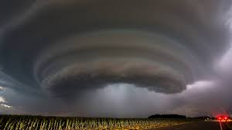
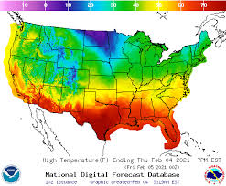
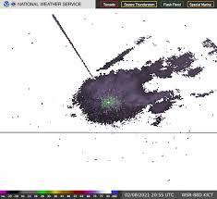
Presentation
Chance Hayes
NOAA
https://www.weather.gov/ict/

Slide 14
Round Table Discussion
Any community educational needs?
Any business relations that we need to reach out to?
Do you have questions about your Emergency Plans?
Do you have questions about Tier II reporting?
?

