Slide 1
2021 Annual Report Sedgwick County Suicide Prevention Coalition

Slide 2
Thank You!
Sedgwick County Health Department
Kaylee Hervey
Juli Vogt
Sedgwick County Regional Forensic Science Center
COMCARE
Michelle Calvert
Jennifer Wilson
Regina Hafner-Stout
24/7 Suicide Prevention Hotline
316-660-7500

Slide 3
2021 Suicide Rate
92 suicide deaths in Sedgwick County.
17.91 suicide deaths per 100,000 Sedgwick County residents.
24/7 Suicide Prevention Hotline
316-660-7500
Notes:
Decrease from previous year, 92 cases (17.91 per 100,000) in 2021 compared to 105 in 2020 (20.44 per 100,000)

Slide 4
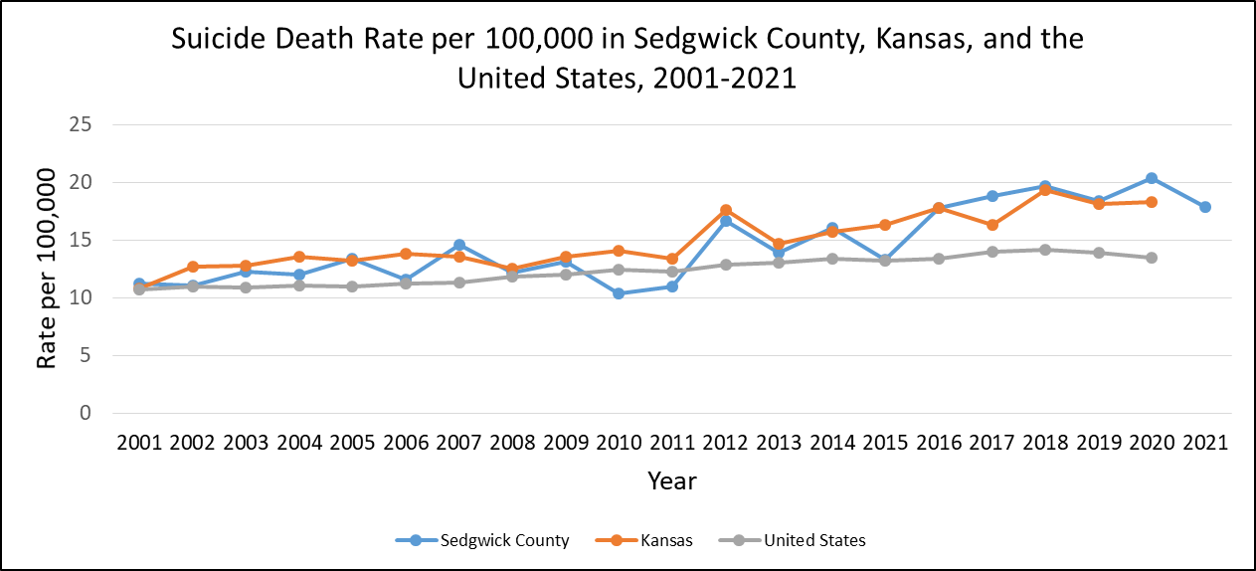
Comparisons with State and National Rates
24/7 Suicide Prevention Hotline
316-660-7500

Slide 5
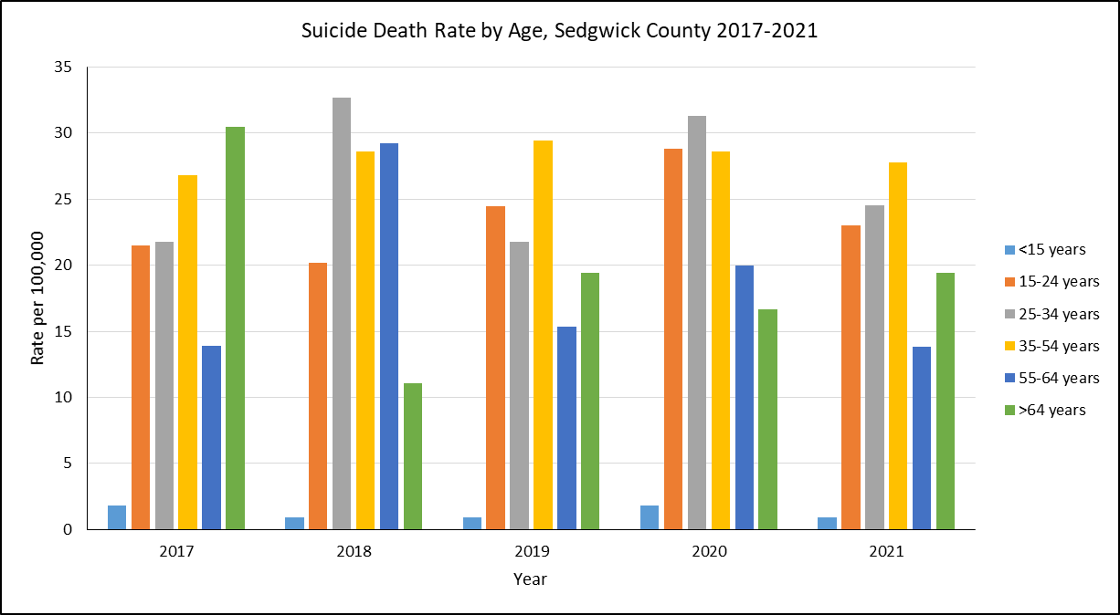
Suicide Rates per 100,000 by Age
24/7 Suicide Prevention Hotline
316-660-7500
Notes:
In 2021, we saw decreases in suicide rates for all age groups except the >64 years. The largest decreases were seen in the 24-34 year olds and the 55-64 year olds.

Slide 6
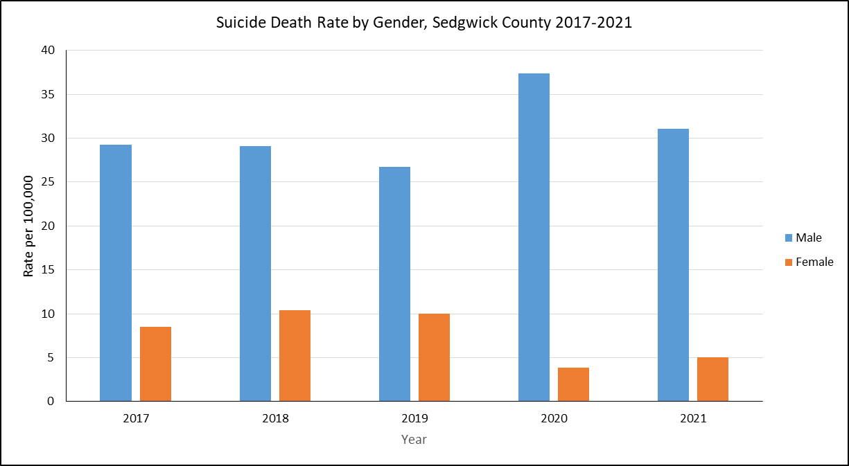
Suicide Rates per 100,000 by Gender
24/7 Suicide Prevention Hotline
316-660-7500
Notes:
Similar to previous years, males made up the majority of suicide deaths in Sedgwick County at 86%. Females constituted only 14% of suicide deaths. (Usually closer to 75/25). However, female suicide death rates increased slightly from 2020 (3.9 per 100,000) to 2021 (5.0), while male death rates decreased (37.4 in 2020 to 31.1 in 2021).

Slide 7
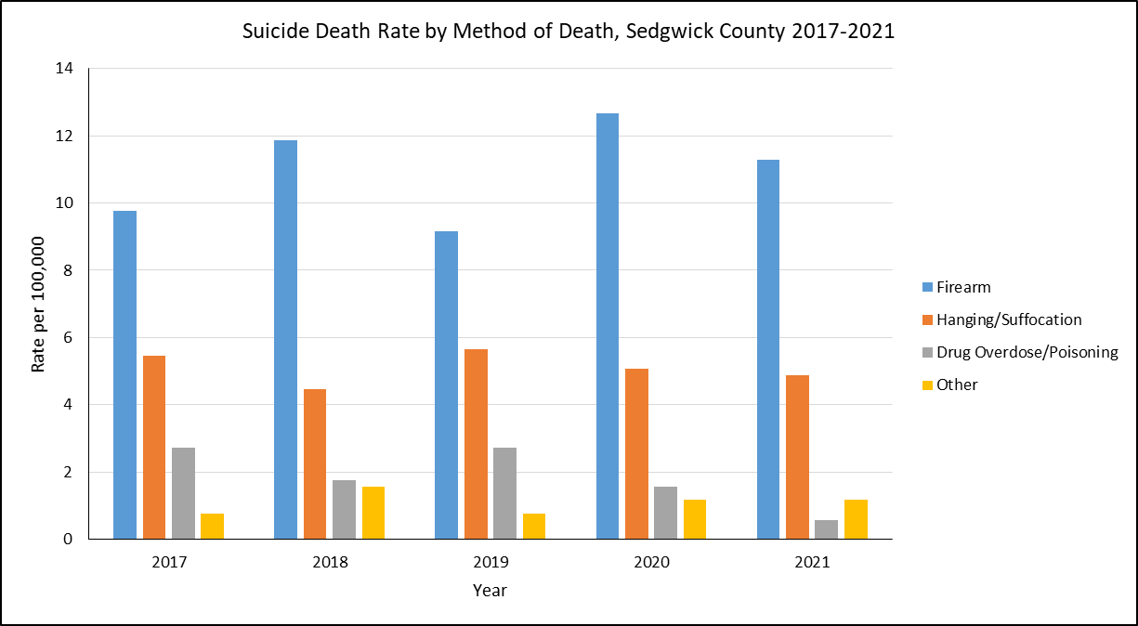
Suicide Rates per 100,000 by Method
24/7 Suicide Prevention Hotline
316-660-7500
Notes:
Firearms continue to the most common method of suicide at 63% of cases, followed by hanging/asphyxiation at 27%, then by other methods at 7% of cases. All methods of death decreased from the previous year except for other methods.

Slide 8
Mental Health and Suicide History
40 percent of deaths had known history of mental illness
Depression was the most commonly noted mental illness
Anxiety was the second most common
48 percent of deaths had known history of suicidal ideations
20 percent of deaths had known history of previous suicide attempts
36 percent of deaths had known history of medical illness
29 percent of deaths had known history of substance misuse
Alcohol misuse was the most commonly noted substance
Illicit drug use was the second most common

Slide 9
Life Stressors by Age
Notes:
Same patterns as seen in previous years
Relationship stressors most common in younger suicides
Physical health stressors most common in older suicides
Only 2% of deaths mentioned COVID-19 specifically (1 job loss, 1 recent death of family member)
19% of deaths were veterans-this is higher than in all previous years since we began collecting this data except 2017 (23%). Usually it’s around 11-12%

Slide 10
Life Stressors by Age: 2017-2021
Notes:
Relationship stressors most common in younger suicides
Physical health stressors most common in older suicides
2021: Same patterns as seen in previous years
Only 2% of deaths mentioned COVID-19 specifically (1 job loss, 1 recent death of family member)
19% of deaths were veterans-this is higher than in all previous years since we began collecting this data except 2017 (23%). Usually it’s around 11-12%

Slide 11
Local Suicide Prevention Efforts
Mental Health First Aid
86 people trained in MHFA in 2021
316 trained so far in 2022, 11 more classes scheduled
Expanded partnerships with community businesses to offer trainings in 2022
3 Zero Suicide Mini-grants
Trained 28 in Question-Persuade-Refer (QPR)
Provided suicide prevention education and materials to 5 firearm businesses/ gun ranges
Trained 16 in Counseling on Access to Lethal Means (CALM)
Trained 12 in Assessing and Managing Suicide Risk (AMSR)
Trained 14 in Collaborative Assessment and Management of Suicidality (CAMS)
Provided education and technical support for 9 health/behavioral health organizations in the Zero Suicide framework of safer suicide care
Notes:
The Zero Suicide grants were received and carried out in 2021. We received three different mini-grants (two under the coalition and one under StopSuicideICT) which was a little under $15k total. With those funds, we were able to train 28 in QPR, educate 5 firearm businesses/gun ranges about suicide prevention and lethal means, provide those businesses with 50 flyers and brochures, train 16 in CALM, 12 in AMSR, and 14 in CAMS, educate 9 health/behavioral health organizations about Zero Suicide, with 4 of those 9 engaging in implementation of the Zero Suicide framework in their agencies.

Slide 12
988
Notes:
The new dialing code to connect to the National Suicide & Crisis Lifeline started on July 16, 2022. (316) 660-7500 will also remain active.
A direct connection to compassionate, accessible & highly trained support for anyone experiencing mental health related distress
The crisis could include thoughts of suicide, mental health or substance use crisis, or any other kind of emotional distress
This change is meant to increase access to support for people experiencing mental health distress with one, easy to remember, phone number to call for needed support

Slide 13
Know the Signs
TALK: No reason to live. Feeling trapped. Feeling like a burden to others. Unbearable pain. Talk of killing themselves.
BEHAVIOR: Increased alcohol/drug use. Isolation from family and friends. Sleeping too little/too much. Withdrawing from activities. Seeking access to pills/weapons or other means.
MOOD: Depression. Loss of interest. Rage. Irritability. Humiliation. Anxiety.
24/7 Suicide Prevention Hotline
316-660-7500

Slide 14
What can you do?
Take it seriously, if someone mentions suicide.
Talk openly and matter-of-factly about suicide.
Be willing to listen. Allow expressions of feelings. Accept the feelings.
Offer hope that help is available.
Do not leave him or her alone.
Get help immediately!
24/7 Suicide Prevention Hotline
316-660-7500

Slide 15
Get Involved
Community Health Improvement Plan
Contact Daisey Urbina-Ceja Daisy.Urbina-Ceja@sedgwick.gov
Mental Health First Aid classes for youth and adults
Sept 23, Oct 7, Oct 28
Contact Danette Abernathy 660-7850
https://ichoosetotalk.org/
Party for Prevention Sept 8
https://www.eventbrite.com/e/338210676237
Suspenders4Hope Run/Walk October 1
https://runsignup.com/Race/KS/Wichita/Suspenders4Hope5kand1Mile
24/7 Suicide Prevention Hotline
316-660-7500
Notes:
Zero Reasons Why coming to SC

