Slide 1

Local Judicial District Responsibilities
1d
Notes:
Alex

Slide 2
Sedgwick County Department of Corrections - JIAC
Sedgwick County Department of Corrections Juvenile Intake and Assessment Center (JIAC) consists of 3 programs:
  Juvenile Intake, Assessment, Release
  Immediate Intervention Program (IIP)
  Coordination of Services (POWER Program)
Notes:
Alex

Slide 3
JIAC – Intake, assessment, release
24/7 program
Police drop offs: youth arrested in Sedgwick County between the ages of 10-17
  Officer Release Form
  QMHP Release Form
Notice to Appear/Agreement to Appear (NTA/ATA)
150 referred youth/month
Notes:
Alex

Slide 4
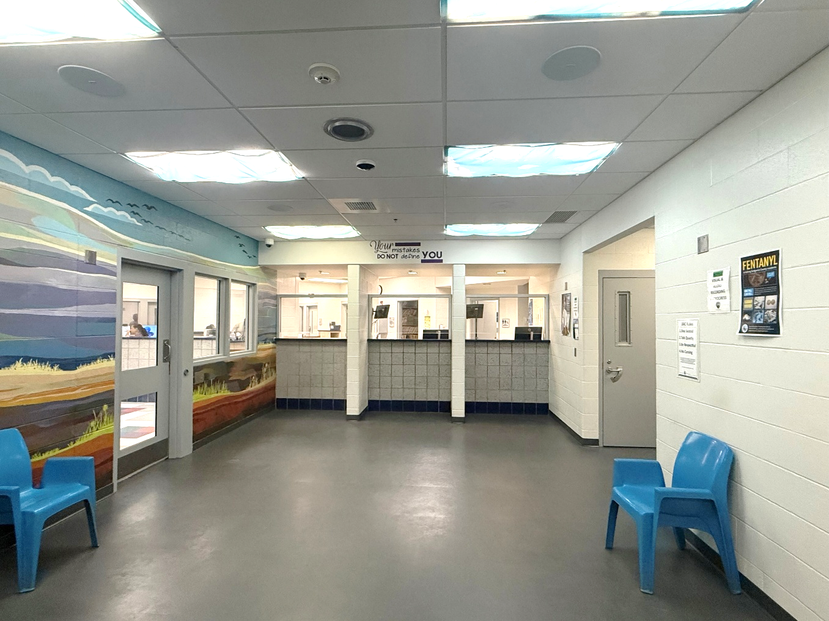
JIAC – intake, assessment, release 2
Intake (Booking)
  Mug/tattoo photos
  Fingerprinting
  DNA collection
(Photo of intake area)
Notes:
Alex

Slide 5
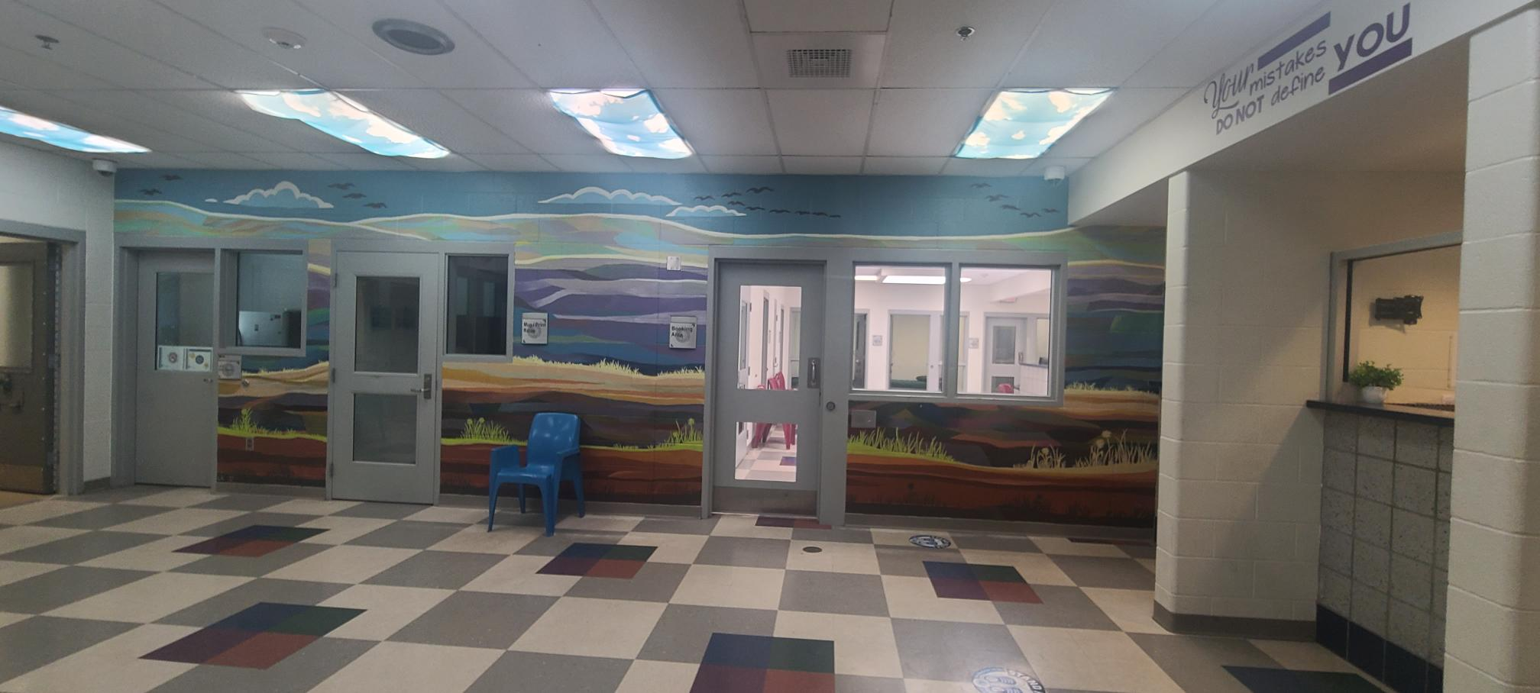
JIAC – intake, assessment, release 3
Notes:
Alex

Slide 6
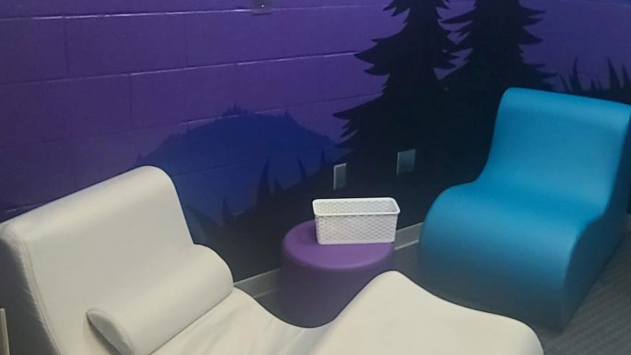
JIAC – Intake, assessment, release 4
Assessment
  Kansas Detention Assessment Instrument (KDAI)
  Human Trafficking Screening Instrument (HTSI)
  Juvenile Relational Inquiry Tool (JRIT)
  ASQ & MAYSI-II
  Substance use
  Family/home life
  Education
  Peer relationships
  Mental & physical health
  Risk for Reoffending (RFR)
Notes:
Alex

Slide 7
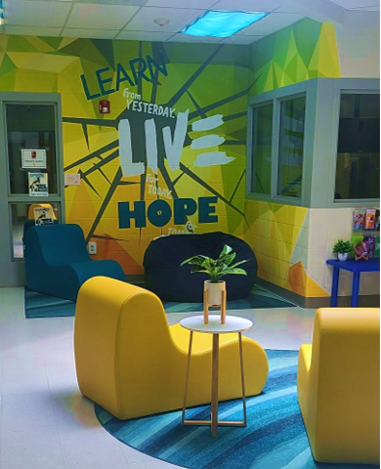
JIAC – intake, assessment, release 5
Release
  Contact family/guardian or release to JDF or PPC
  Family conference
    Identified risks/needs
    Medical release, if applicable
    Referrals to community agencies
    Next steps
Notes:
Alex - When we meet with the family, we review the details of the arrest, what to expect from the Courts (they can file for up to 5 more years for most offenses)
We review the RFR and offer a referral and answer any questions the family may have.
A lot of times, families are in crisis, due to the events of the day, or overall stressors, so we do a lot of “situational crisis counseling” which includes a lot of listening and then providing resources as needed.

Slide 8
JIAC – Immediate Intervention Program (IIP)
Each jurisdiction in Kansas is required to offer an IIP
Eligibility is based on previous record and current offenses
Pre-file only
Voluntary participation in 16-week program
A multi-disciplinary team (MDT) reviews progress
Notes:
Alex

Slide 9
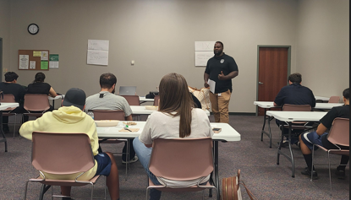
JIAC
POWER Program
Providing Opportunities While Ending Recidivism
Educational & highly interactive program for low-risk youth & their connected adult
Community partners come together to provide education & services in an effort to:
    Reduce recidivism & risky behaviors
    Improve relationships between youth & caregivers
    Connect with community resources
Notes:
Jamarae

Slide 10

Sedgwick County Juvenile Field Services 18th JD
Sedgwick County Juvenile Field Services (JFS) consists of 3 programs:
  Community Supervision (JISP/JCF/CR)
  Homebased Supervision (HBS)
  Evening Reporting Center (ERC)
Notes:
Kevin
Three programs under the Juvenile Field Services

Slide 11
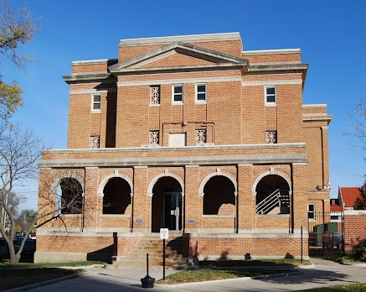
Community supervision (JISP/JCF/CR)
ISO’s work out of the Juvenile Field Services Office in Sedgwick County. ISO’s supervise youth sentenced to JISP, JCF and CR.
Notes:
Kevin
ISO’s manage a caseload of youth placed on JISP, JCF (KDOC-JS Custody for a Direct Commit) and CR (post JCF release supervision).

Slide 12
Juvenile Intensive Supervised Probation (JISP)
Youth are placed on Intensive Probation for a time period determined by the court
Youth are assigned a level of supervision based on YLS score
ISO’s make referrals to community-based resources
Monitor compliance with court orders, issue graduated responses (VLR’s) for violation, award incentives and report progress back to the court
Award or Deny Earned Discharge Credits (EDC’s)
Keep YLS and Supervision Plan current
Notes:
Kevin
Juvenile Intensive Supervision Programs (JISP) -- JISP is an intensive community based program providing services and supervision to clients for a time period set by the court. Youth are supervised based on the conditions ordered by the Judge and referrals are made to service providers in the community.
Level and Score – Very High placed on level 1; High risk on level 2; Moderate on level 3, Low on level 4. Contacts and programming hours match risk level
Referrals – ERC program; Function Family Therapy (FFT); Treatment (Drug and alcohol, SO, etc.); Anger Management; Education Services; EBP hours
VLR’s – Violation Level Report for technical violations in conjunction with an Epics II tool.
EDC’s – If a youth makes significant progress towards completion of their court orders for an entire calendar month, they receive 7 days off their term.

Slide 13
Juvenile correctional Facility (jcf)
Youth placed in the Kansas Department of Corrections – Juvenile Services Custody for placement at the Juvenile Correctional Facility
ISO’s maintain regular contact with the youth, family/guardian and CCII while the youth is at the JCF to monitor behavior and progress
Participate in pre-release planning
Notes:
Kevin
Pre-Release Planning – Identify where the youth will be placed, post-release recommendations and referrals for services that need set-up for when the youth returns to the community. Preference is always to have youth reintegrate home if possible.

Slide 14
Conditional Release (CR)
ISO’s provide post release supervision on youth released from the JCF that are placed on Conditional Release for a period of time
Goal is always to place the youth in the community with parent or other family member
ISO’s will make referrals to community-based services and get the youth in an education program or job skills program depending on need
Notes:
Kevin

Slide 15
Homebased Supervision (HBS)
Supervise youth authorized for Homebased Supervision in lieu of detention
Ensure the youth follows the conditions of their release
Report violations to the Judge
Complete court reports for court hearings
Juvenile Pretrial Program (JPP)
Notes:
Kevin
Conditions of Release – Placement on EMD, Placed on Lockdown, Required to get D&A Evaluation, Enroll in school, etc.
JPP Program – HBS staff monitor youth authorized for release from JDF on JPP. Terms of supervision are outlined by bond conditions imposed by the court. Goal is to ensure that clients are following bond conditions and appear for scheduled court hearings as well as regular HBS duties outlined above.
Term – Youth remain on HBS until they successfully complete and the Judge orders them off HBS; They violate and a warrant is issued, client is sentenced to some form of probation.
Not eligible from HBS if already on probation

Slide 16
Strategies to address behavior change
  Strategies to Address Behaviors:
  Graduated Responses/Violation Level Report (VLR)
  Effective Practices In Correctional Settings (EPICS-II)
  Referral to the Evening Reporting Center (ERC) for cognitive behavioral intervention groups, education assistance, employment support, substance abuse resources, and individual case management
  Use the 4:1 Incentive to Sanction Ratio
  Coaching Model for Change – Partnered with Justice System Partners
Notes:
Kevin
Graduated Responses – if a youth violates a condition of probation. The supervision officer competes a Violation Level Report which contains a response grid. In addition to a response, the supervision officer utilizes a cognitive behavioral intervention with EPICS II skills. All of this is documented. After the third or subsequent violation, along with demonstration that prior responses have not worked to reduce a behavior, the supervision officer CAN request a revocation by the court.
Family Therapy with Eckerd

Slide 17
Evening Reporting Center (ERC)
Groups and Services offered by ERC:
  In-Person Programming
  Virtual Programming
  Community Resources
  Community Service Work
  Education Services
  Substance Abuse Treatment
Notes:
Kevin
In-Person Programming – Youth report to ERC and receive in person evidence based programming
Virtual Programming – Offered to youth in surrounding counties and youth that live outside the Wichita Metro Area
Community Resources – Connect youth and families with services in the community. Assist with applying for medical card; birth certificate; SS card, etc.
CSW – Youth that are court ordered to complete CSW or received CSW as a graduated response can complete at ERC; Complete CSW projects in the community as well
Education Services – Suspended or expelled youth; GED; Virtual/On-line schooling; tutoring and supervision while completing work
ERC is was created with the idea of youth having a one-stop shop to receive all their programming in one place and remove barriers such as transportation

Slide 18
Evening Reporting Center (ERC) 2
Groups Offered:
  Boy’s Council
  Forward Thinking
  Girl’s Circle
  GROWTH
  Protect Your Mind
  Safe Dates
Notes:
Kevin
GROWTH – Gratitude, Responsibility, Ownership, Truthfulness and Humanity

Slide 19
Evening Reporting Center (ERC) 3
Services Offered:
  Evidence-based Cognitive Behavioral Interventions
  Education Assistance – Includes GED prep, tutoring, online enrollment, and credit recovery funds
  Substance Abuse – D&A Evaluations and funds for treatment if needed
  Employment Assistance
  Partnerships with One Heart Project and School Halls not Prison Walls (Protect your Mind)
Notes:
Kevin
PEACE – ART: Developed by same people that assisted in the development of ART; Involves 3 core components of: Self Control, Essential Social Skills and Problem Solving; Can be done in smaller groups and one-on-one sessions if needed. Better fit than traditional T4C to meet needs of the youth we serve.

Slide 20
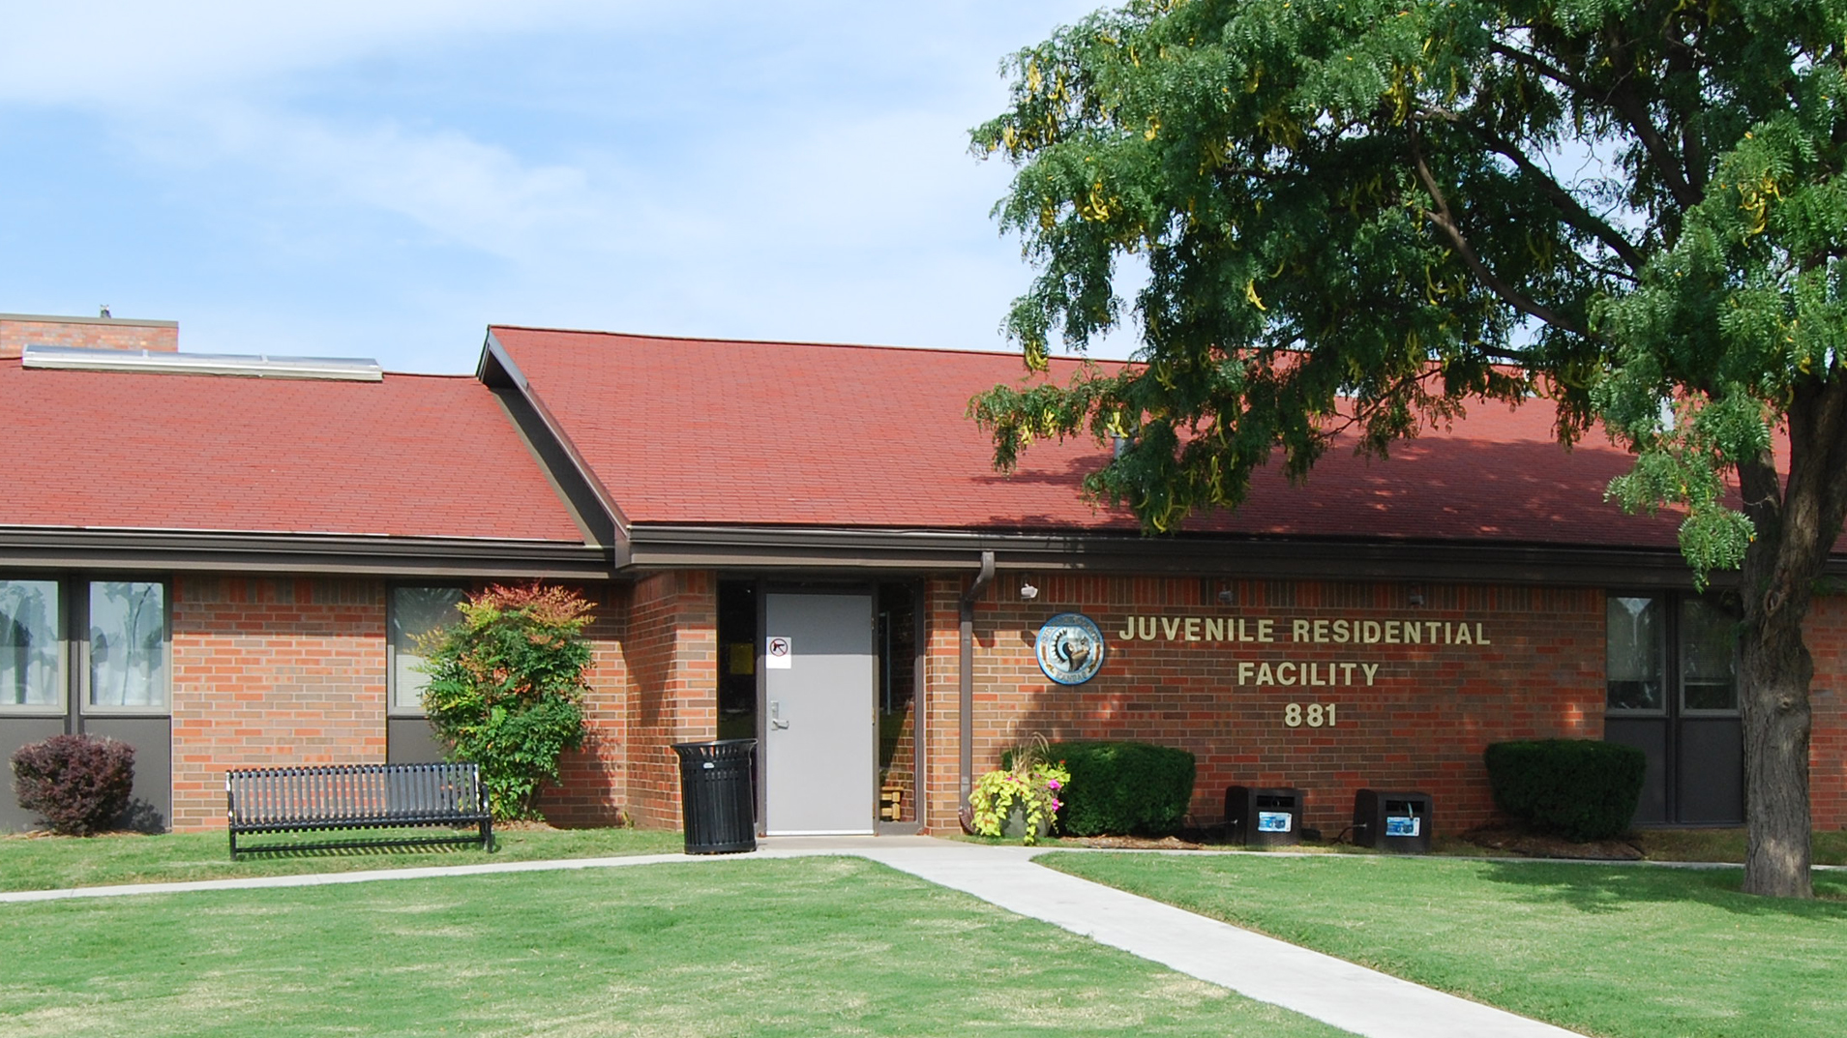
Juvenile Residential Facility (JRF)
Notes:
Kevin

Slide 21
Partnership with dcf/emberhope
October of 2024 JRF entered into an agreement with DCF to serve crossover youth as a short-term emergency placement (30-days)
Notes:
Kevin

Slide 22
Placement criteria
Youth must be between ages of 12-17
Considered a “cross-over youth” by definition
Notes:
Kevin
Cross-over definition: individuals who are involved in both the child welfare system and the juvenile justice system. Youth must have had a negative law enforcement interaction within 90 days of admittance. Negative law enforcement interactions include but are not limited to:
Arrested or received referral to JIAC (Notice to Appear)
Charged with a crime
Received a citation or ticket
Received a probation violation
Had a negative interaction where law enforcement was involved

Slide 23
Exclusionary factors
Actively suicidal or recent suicide attempt
Displaying behaviors and symptoms of a psychotic disorder
Mental or behavioral health conditions that require constant monitoring or 1:1 staffing to maintain placement
Medical conditions that require constant monitoring by a physician or other health care professional
Signs of acute illness that appear to need immediate medical care
Signs of intoxication with significant impairment in functioning
Detoxing from drugs or alcohol
IQ of 70 or below
Currently placed at Secure Care Center
Currently engaged in CDDO (County Developmental Disabilities Organization) services (as this could limit access to services)
Notes:
Kevin

Slide 24
18th Judicial district contact information
Steven Stonehouse, Director (316) 660-9753
Mario Salinas, Deputy Director of Juvenile Services (316) 660-7014
Alex Allbaugh, Corrections Coordinator JIAC (316) 660-5356
Kevin Cocking, Juvenile Residential & Community Supervision Administrator (316) 660-5395
Stacy Bell, Juvenile Intake and Detention Administrator (316) 660-1654
Larry Burks, Evening Reporting Center Program Manager (316) 660-5401

