Slide 1

Crossover YOUTH Practice Model, protocols, SGCO DATA & Crossover MDT’S
Elisa Thompson, Crossover Youth Facilitator
DCF/JIAC

Slide 2
Crossover Youth Practice Model (CYPM)
The Center for Juvenile Justice Reform at Georgetown University developed this model for improved communication across agencies to better serve youth and families.
The goals of the CYPM model are:
Reduce the number of youth in foster care
Reduce the number of youth in congregate care
Reduce the disproportionate representation of children of color in both systems
Reduce the number of youth that become dually adjudicated

Slide 3
Cross-System Facilitator role
Sedgwick County is the only county currently in the State with a dedicated staff member able to access both child welfare and juvenile justice systems. This is essential for coordinating cases effectively and incorporating the CYPM model. This dedicated position is an evidence-based grant funded position applied for by DCF and KDOC.
Open lines of communication and case collaboration across the different agencies in SGCO.

Slide 4
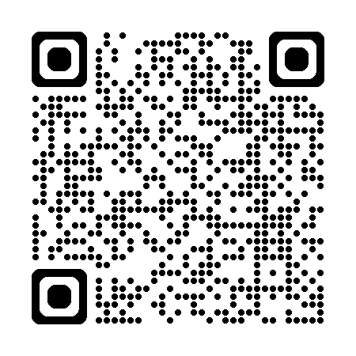
Crossover Youth Protocols
Last year the Sedgwick County CYPM group developed a road map for working with crossover youth.
This is a living document that establishes best practices for serving our population of crossover youth.
It was designed with input from all the agencies that participated in today’s training but is specific to Sedgwick County.

Slide 5
Data Trends
In a typical year there are around 370 youth served by the facilitator role.
In 2025, 442 youth were served, this is the most youth to date.
The increase in clients served also shows an increase in youth being arrested

Slide 6
Crossover Youth MDT Meetings
Crossover Youth MDT Meeting Criteria
Meeting Format
Goal – reduce system involvement for both child welfare & juvenile justice involved youth.
Youth meeting crossover definition
Youth with more than one arrest in 1 month
Youth with 3 or more arrests in 90 days
Short, 30 minute meetings to discuss current case status.
Consists of caseworkers directly working with youth/family and those who may have services that could benefit the youth/family.
Family not in attendance
Recommendations made with follow up steps

Slide 7
Qualified for a meeting but did not have one..
Youth remained in detention after qualifying, went AWOL or to a PRTF, or were youth not in EmberHope custody.
Other types of meetings held include DCF Team Decision Making Meetings, or Failure to Place staffings for EmberHope kids.

Slide 8
Data Outcomes
59 youth qualified for a Crossover MDT meeting last year, however only 5 occurred due to other relevant staffings coinciding.
Out of the 12 DCF Team Decision Making Meetings 9 successfully engaged in preventative DCF Services like Family Preservation or MST, 1 youth came into FC, the other 2 were already on probation.
Out of the 5 Crossover MDT meetings held, 3 were in foster care and services were recommended, 1 entered DCF custody soon after, and 1 accepted MST services.
Out of the 24 EmberHope TDM’s, the crossover facilitator attended all meetings and informed participants of recent arrests, charging appointments, and possible services.
Compared to last year data stable across all domains except the EH TDM’s doubled for these youth indicating youth with frequent rearrests also had placement instability.

Slide 9
Thank You
Elisa.Thompson@ks.gov
316-660-5365
316-570-4240 work cell

