Slide 1
Juvenile Justice
Court Process
Notes:
Welcome to the Juvenile Justice Court Process. During this orientation, we will be exploring the process that a youth goes through within the court system. We will also explore the Court Service Officer’s role and a few of the duties they have with the youth and families.

Slide 2
Court Process
Detention Hearing
First Appearance
Plea Hearing
Assessments
Disposition Hearing
Notes:
After arrest, the youth will go through several steps within the court. Starting with the Detention hearing and ending at the Disposition hearing. Each step is regulated and dictated by Kansas State Statute.

Slide 3
Detention Hearing (KSA 38-2343)
48 hrs from detention admission
Alleged crime must equal adult felony or misdemeanor
Detention Review Hearing is conducted at least 14 days from the Judge’s detention order
Notes:
According to KSA 38-2343, the detention hearing is an informal hearing that takes place within 48 hours of the youth being placed in juvenile detention. The Judge can order the youth to remain in detention if it is determined that the youth continues to be a risk to the public.
If the youth is remanded to detention, a Detention Review hearing is scheduled no more than 14 days from the Detention Hearing. The review hearing is to gauge if the youth continues to be a risk to the public and remain in detention. A review hearing is scheduled every 14 days that the youth is in detention.

Slide 4
Immediate Intervention Programs
K.S.A. 38-2346
  Pre-file
  Post-file
K.S.A. 38-2393 Multidisciplinary Teams
K.S.A. 38-2395 Standards
Notes:
The Immediate Intervention Programs (IIP) is a diversion type program that can be referred pre or post-file. Here the youth is able to complete specific programs, classes, or tasks based off risks and needs of the individual. An IIP generally doesn’t last longer than 6 months. If a youth doesn’t successfully complete the terms of an IIP plan, the youth can be referred to an MDT. The Multi-disciplinary Teams meet to discuss progress towards completion of the IIP. The MDT facilitator invites the youth, family, educators, clinicians, and any other professional to be a part of the MDT. The MDT may either revise and extend the IIP plan or can decide the youth has successfully completed the plan. If the plan is revised and extended and the youth fails to meet the extension requirements, the case can be referred back to the county or district attorney. If the IIP is completed successful, the charges may not be filed (pre-file IIP) or can be dismissed (post-file IIP).

Slide 5
First Appearance
Formal charges are read
Attorney is appointed if private counsel is not retained
Can be referred to Diversion
Notes:
During the first appearance, the formal charges are read of the alleged crime. An attorney is appointed if private counsel is not present. The youth my be placed on a Diversion program but must meet certain criteria.

Slide 6
Plea Hearing
Plea of Not Guilty, Nolo Contendere or Guilty
Pre-Disposition Investigation ordered
Youth Level of Service/Case Management Inventory ordered
Notes:
The youth has the opportunity to plea Guilty (admitting guilt), Nolo Contendere/No Contest (accepting conviction but not admitting guilt), or Not Guilty (did not admit to guilt). To determine the possible sentence or supervision the Youth Level of Service/Case Management Inventory assessment (YLS-CMI) is ordered along with the Pre-Disposition Investigation (PDI). The PDI is similar to the Adult version of the Pre-Sentence Investigation or PSI.
With a guilty or no contest plea, the courts schedule a disposition hearing. When a youth pleas not guilty, a trial is scheduled.

Slide 7
Guiding Assessments
Notes:
The CSO will then complete two assessments. Both explore the history of the youth ranging from education, parental interaction, to past charges or arrests.

Slide 8
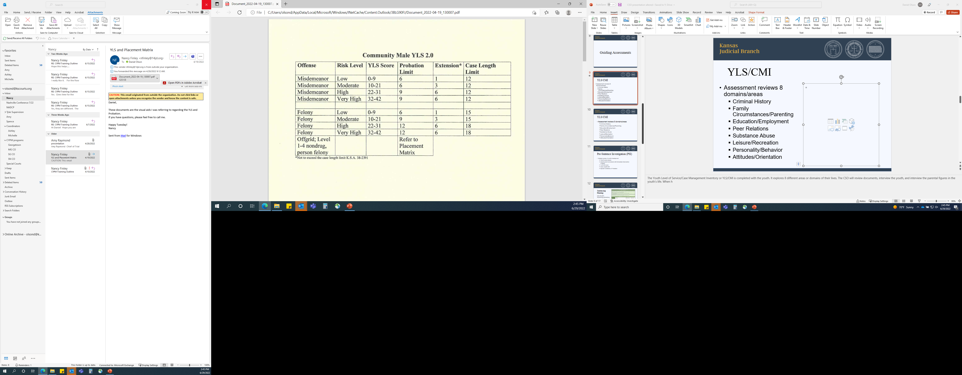
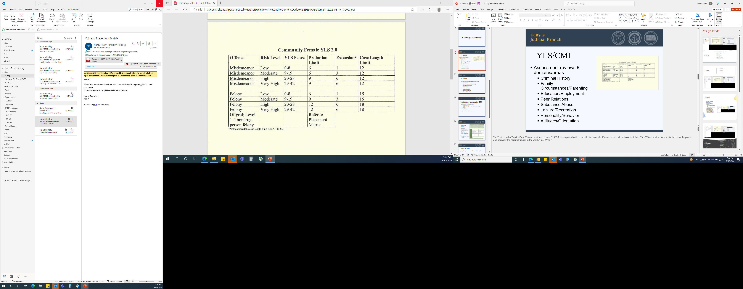
YLS/CMI
Assessment reviews 8 domains/areas
  Criminal History
  Family Circumstances/Parenting
  Education/Employment
  Peer Relations
  Substance Abuse
  Leisure/Recreation
  Personality/Behavior
  Attitudes/Orientation
Notes:
The YLS/CMI is an assessment that reviews 8 domains or areas of the youth’s life. Criminal history, education, employment, peer relations (who they are friends with), and leisure/recreation (free time). The supervision officer (both Court Services and Community Corrections) completes this with a conversation type interview with the youth and with the family. It tells us what areas that the youth has had past struggles with as well as identifies barriers that are in place. It is to be completed prior to Disposition Hearing.

Slide 9
Pre-Disposition Investigation Report
Detailed review of youth’s background
  Prior/Current arrests
  Prior/Current involvement with the Court
  YLS/CMI score
  Case Length limit
  Special Conditions of Probation
Notes:
The PDI is used to assist in sentencing of the youth. The main purpose of the PDI to determine what sentencing length and if probation is appropriate. They YLS/CMI, PDI, and Sentencing Matrix is used in conjunction to determine the type of sentencing. These assessments are completed by the CSO as ordered by the judge.

Slide 10
Case Length Limit and Probation Limits
K.S.A. 38-2391
Based on the adjudicated crime and risk level
Does not apply to off grid crimes, some sexual crimes, and murder
Begins upon disposition or 15 days after adjudication
Notes:
As mentioned before, SB 367 made changes to the juvenile justice system. One of these changes was the case length. The intent of this was to restrict over punishing youth for crimes who were lower risk. It developed a guideline for youth to prevent over sentencing.

Slide 11
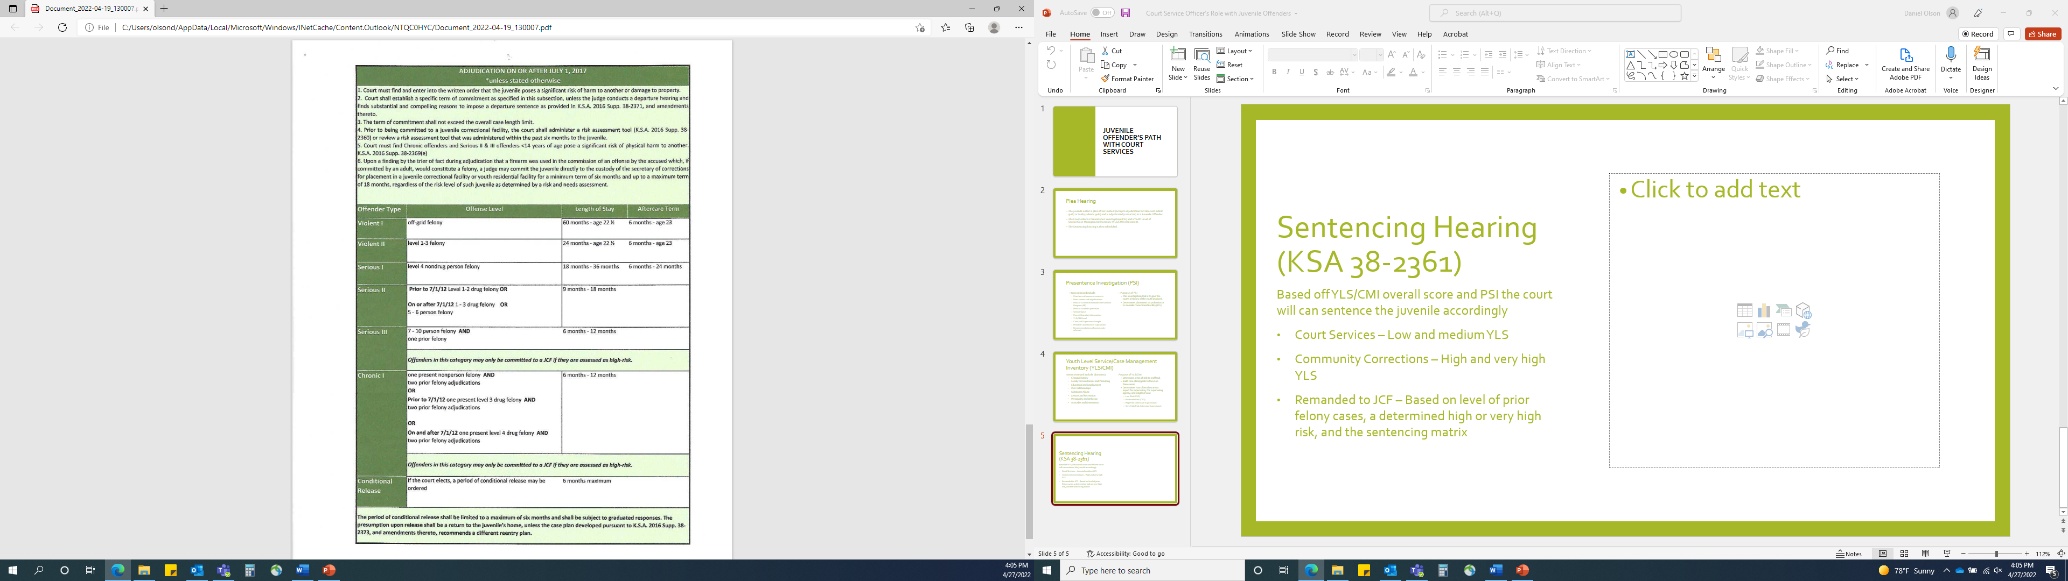
Disposition
Hearing
KSA 38-2361 Sentencing alternatives
Low and Moderate overall YLS/CMI score – Court Services
High and Very High overall YLS/CMI score – Community Corrections
Remanded to Juvenile Correctional Facility – prior felony cases, high or very high risk, and sentencing matrix
Notes:
When sentenced to supervised probation, the youth can be monitored by either Court Services or Community Corrections (Intensive Supervision). The YLS/CMI score assists in determining supervisions type. Typically, low and moderate risk is monitored by Court Services, while high and very high are monitored by Community Corrections. Keeping in mind that this is typical but not always the case. At times the score can be low which indicates Court Services supervision but based off some factors, the youth can be ordered to be monitored by Community Corrections. A youth can also be sentenced to Court Services and as a graduated response for not following the conditions of probation, a Judge can remove a youth from being monitored by Court Services and order to be monitored by Community Corrections. The youth can also score to be sentenced to the Juvenile Correctional Facility which is the Kansas Juvenile Correctional Complex. This is for youth who have what would be equal to an adult felony, score high or very high with the YLS/CMI, and it falls in the sentencing matrix guidelines.

Slide 12
Probation Paths
Court Services
Community Corrections/Intensive Supervision
Judicial Branch
Completes PDI and YLS/CMI for sentencing
Typically lower risk offenders
Kansas Department of Corrections
Completes YLS/CMI after Disposition
Typically higher risk offenders
Notes:
Court Services and Community Corrections are similar in nature. They both monitor youth on probation, complete assessments, develop case plans bases off these assessments, communicate with family, and utilize community resources that will aide the youth in completing probation successfully. One of their focal points is help the youth gain the tools they need to increase prosocial interactions and help overcome any barriers that are in place. Court Service Officers are with the Judicial Branch while Community Corrections Officers are county employees who is funded with grant money from the Kansas Department of Corrections. Typically, Community Corrections will have more frequent meetings and have stricter guidelines. Keeping in mind again, that this is not always the case. Both entities use evidence-based supervision practices when working with youth.

Slide 13
Court Service Officers
Conditions of Probation based on KSA 38-2361
Special conditions based on case plan review
Vital Community Resources
Case planning
Evidence Based Programs
DNA Collection KSA 21-2511
Rule 106(c)
Notes:
Court Service Officers meet with youth and family members on a regular basis. The frequency is determined by the YLS/CMI score. CSOs also collaborate with any agency that is associated with the youth. Examples are school officials, mental health providers, and treatment providers.
With the information gained from the collaboration with the outside agencies, the CSO will work with the youth and family to develop a case plan. The case plan is a road map for a youth to successfully complete probation. It also gives them the tools they need to overcome obstacles they face when they are not on probation. The YLS/CMI is a tool that helps determine what areas of risk and needs the youth have, and goals are created around these risk areas.
CSOs records are confidential due to Supreme Court Rule 106(c). This rule states that all CSO files, including notes, are not subject subpoena or other process.

Slide 14
Areas of focus
Risks
Needs
Static factors (areas that can not change)
Dynamic factors (areas that can change)
Barriers
Compares “what is” and “what could be”
Notes:
Another benefit of the YLS/CMI assessment is that it determines risks and needs of the youth. Both are important areas and is the focal point of case plans. Risks have Static and Dynamic areas. Static factors refer to areas that can not be changed such as criminal history, past substance abuse, and family dynamic. Dynamic factors are areas that can be altered. Things like Education, current employment, and current drug/alcohol usage would be considered dynamic factors.
Needs are items that show what current behaviors are and what the behavior could be. It is a way to determine barriers that are in place and the CSO will develop goals and strategies to overcome them. If an individual has a barrier of transportation, the youth/family will work together with the CSO to determine what can be done to get the individual to their destination.

Slide 15
Earned Discharge Credit
K.S.A. 38-2398
Rule 1801
  Earn credit for each month of substantial compliance with probation conditions
  Seven days credit beginning first full calendar month after placement on probation
Notes:
While on supervision, the youth can earn credit for following the terms of probation. This is an incentive for the youth to follow the conditions of probation and can reduce the probation term. This is like the adult system and “good time” credit for following basic terms.

Slide 16
Graduated Responses and Incentives
K.S.A. 38-2392
2017 AD 292
Probation may be revoked only after
  Third or subsequent technical violations;
  Prior responses failed; and
  Probation officer documents that further graduated responses aren’t sufficient.
Notes:
Graduated response is a coordinated effort to address technical concerns while on probation. It dictates what a probation officer can do for technical violations and restricts over “punishing” a youth. Court Service Officers work with the youth and family to make changes to goals to have them be successful. They also use Evidence Based material such as a Behavioral Chain or Cost/Benefits analysis prior to any graduated response. This is an attempt to allow the youth to think through their decisions and learn from their behaviors.

Slide 17
Contact:
Daniel Olson
Crossover Youth Coordinator
olsond@kscourts.org
(785)940-1333

Slide 18
Additional Contact:
Peter Shay
Juvenile Court Services 18th Judicial District
peter.shay@kscourts.gov
(316)660-5560

