Slide 1


Kansas Department for Children and Families
Notes:
Elisa / Kristin

Slide 2
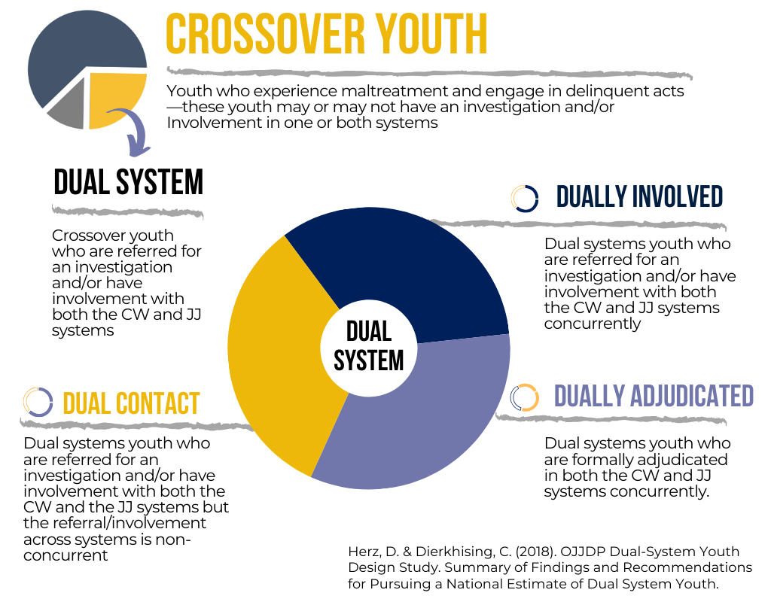
Crossover Youth
Notes:
ELISA
In general Crossover Youth are youth who experience maltreatment and also engage in delinquent behaviors. And while Crossover Youth is the blanket term there are different types of crossover youth and other terminology you may hear. You will hear the Kansas definition of Crossover Youth in a few slides.
Dual System/Dually involved: youth involved with or have a pending referral with both the CW and JJ systems.
Dually Adjudicated = formally adjudicated in both child welfare & juvenile justice systems
Dual Contact = contact with child welfare & juvenile, but at different times.

Slide 3
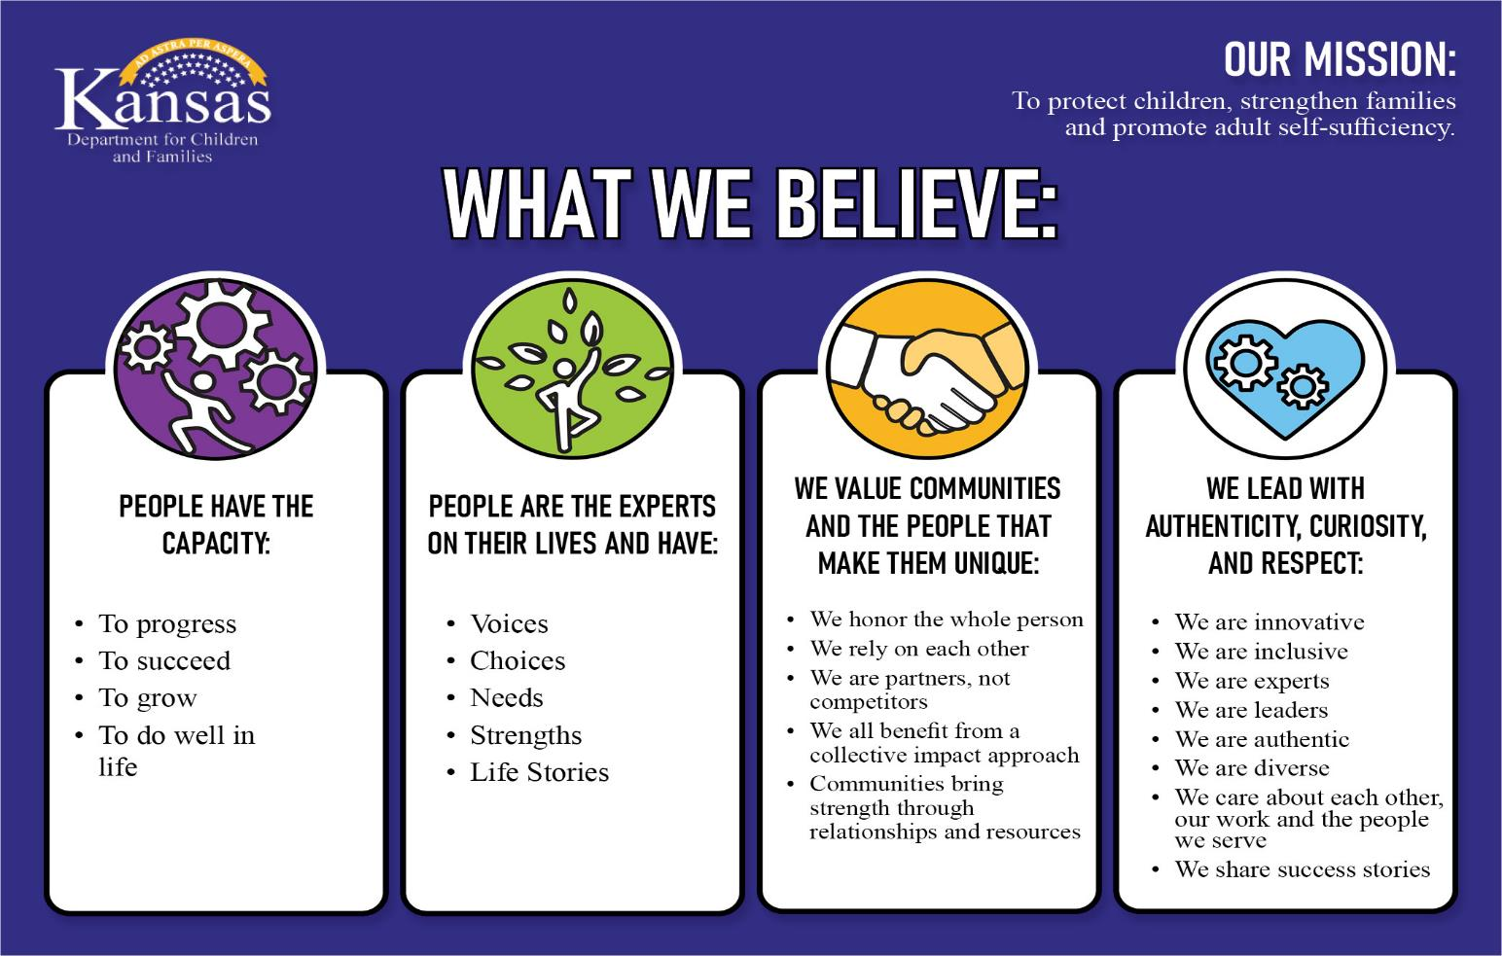
Our Mission
Notes:
KRISTIN

Slide 4




PROGRAM AREAS
Prevention &
Protection
Services
Economic &
Employment
Services
Rehabilitation
Services
Child Support
Services

Slide 5


PREVENTION & PROTECTION SERVICES
Prevention and Protection Services helps families and vulnerable adults by providing:
  Adult Protective Services
  Child Protective Services
  Foster Care
  Adoption Services
  Independent Living Services
  Family Preservation Services
  Family First Prevention Services
Kansas Protection Report Center
1-800-922-5330

Slide 6

PREVENTION & PROTECTION SERVICES 2
Kansas Protection Report Center (KPRC)
FY26 Data
Child Reports Wichita Region – 12,044
Statewide Child Reports – 41,935
Percentage of Reports that are Wichita Region – 28.72%
Open 24/7, 365 days a year
Receives reports on children and
vulnerable adults across the state
Takes reports by phone or web report
Assign based on policy and statutory requirements
Notes:
KRISTIN

Slide 7
Reports & Assignments
Child Protection Workers
Types of Assignments:
Abuse/Neglect: Physical Abuse, Emotional Abuse, Physical Neglect, Medical Neglect, Lack of Supervision, Sexual Abuse, Human Trafficking, Abandonment, Substance Affected Infants, Educational Neglect
Family in Need of Assessment: Caregiver Unable to Care, Caregiver Substance Use, Child Behavior Problems, Child Substance Use, Runaway, Truancy, Pregnant Women Using
Notes:
ELISA

Slide 8
Life of a Report
Child Protection Workers
Report is made to the Kansas Protection Reporting Center (KPRC).
Assessment is completed by a PRC worker.
  Screened Out –information provided does not meet the legal definition of abuse or neglect OR not enough information was provided.
  Screened In – enough information to rise to the level of acceptance
Assigned to the appropriate Region and Office – then assigned to a Child Protection Specialist (CPS) or Child Protection Investigator (CPI).
  Same Day (SD) – Abuse/Neglect – Infants under 1 – Possible Imminent Danger
  72 Hours – Abuse/Neglect – higher risk
  7-day – Family needing Assessments
CPS/CPI will complete an assessment by talking to family members, collateral contacts, etc.
30 Business days to complete the full family assessment – offer services – close assessment and finish paperwork.
Notes:
ELISA

Slide 9
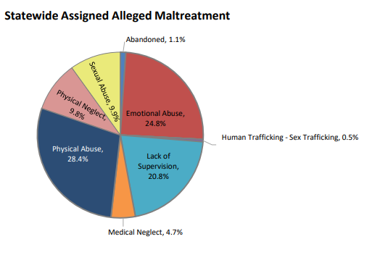
Child Maltreatment
Wichita Region Child Maltreatment reports are highest amongst Physical and Emotional Abuse, followed by Lack of Supervision
July 2025-Jan 2026
Notes:
ELISA

Slide 10
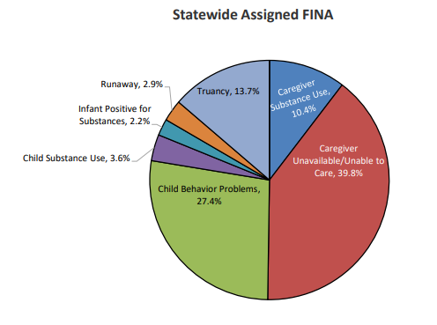
FINA (Family in Need of Assessment) Reports Stats
Wichita Region FINA reports are reports that cause a high number of crossover youth to be impacted by either means of entering foster care or preventative services.
These reports in the Wichita Region are highest for Caregiver Unavailable/Unable to care, followed by Truancy and Child Behavior Problems.
July 2025-Jan 2026
Notes:
ELISA

Slide 11
How is the Kansas Practice Model Different?
Traditional Child Welfare Services
Social Workers and other professional are the experts.
The Agency and social worker usually take responsibility for children’s safety.
The work is anxiety-driven.
Families often feel forced or coerced to “do services”
The focus is often on “fixing” what is wrong.
Cases are closed when families complete the agency’s list of services.
Threats of placement and court orders are commonplace
The work is “noisy” and complex
The Kansas Practice Model
Family members are the experts on their own situations.
Responsibility for children’s safety is with the family and their natural network.
Anxiety is reduced.
Families decide how they will overcome the agencies and other’s worries.
Casework focus is on building from what is right.
Cases are closed when families, networks and professionals are confident about future child safety.
Authority is used skillfully.
The work is simple and concrete
Notes:
ELISA
Child Protection Prog. Admin Stephanie Uhlik Stephanie.Uhlik@ks.gov
Child Protection Prog. Admin Anne Ellis Anne.Ellis@ks.gov
Foster Care Prog. Admin Kristin Peterman Kristin.Peterman@ks.gov
TDM Supervisor Sylvia Brown Sylvia.Brown@ks.gov
– The Kansas Practice Model recognizes family members are the experts and that family members and their networks are what insures the safety of children, not a service that has been put in place.
Families often feel forced and coerced to do services and cases are closed when families complete our agency’s list of services. We find cases where we go to court and didn’t feel comfortable in sending the children home or closing a case as we didn’t see the every day care of the children change. But because the family completed the checklist of services, the Judge would usually close the case.
With the new Kansas Practice Model, we are moving to families deciding how they will overcome the agency’s and other’s worries. And cases are closed when families, networks, and other professionals are confident about the children’s future safety. Requiring different levels of accountability to demonstrate that the children can be safe long term.

Slide 12



Danger / Risk / Safety
Danger is an imminent likelihood of serious harm.
Safety is the condition of being protected from harm.
Immediate Safety is the condition of being protected from danger.
Lasting Safety is the condition of being protected from risk
Risk is the possibility of future harm.
Notes:
ELISA

Slide 13
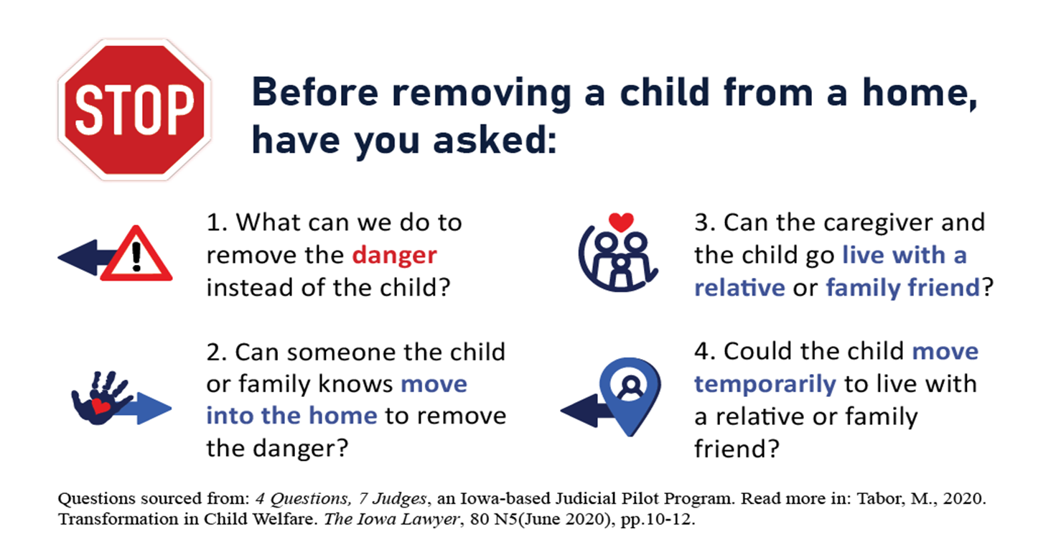
4 Questions
Notes:
ELISA

Slide 14
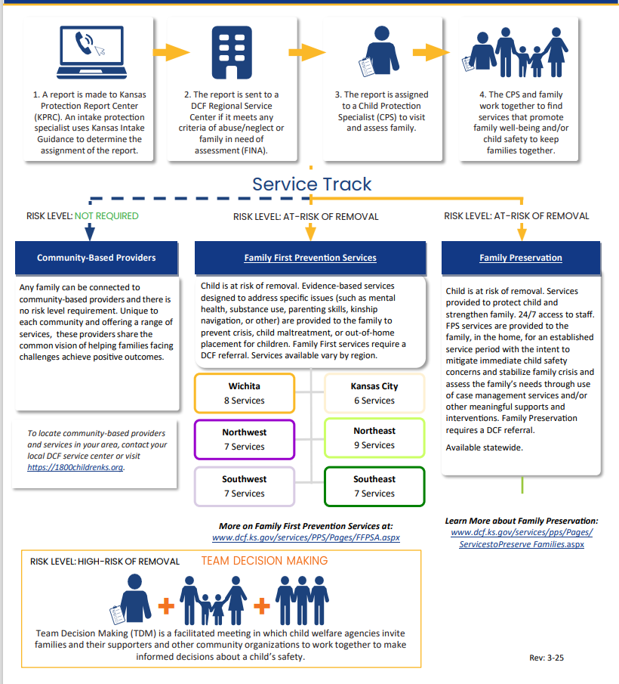
Kansas Prevention Services Track
Notes:
Elisa

Slide 15
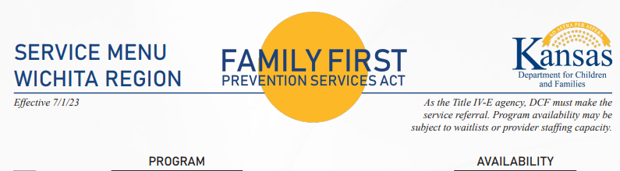
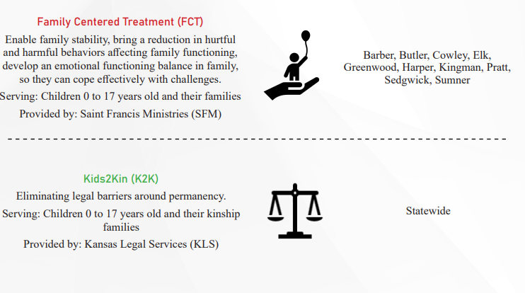
15
Notes:
elisa

Slide 16
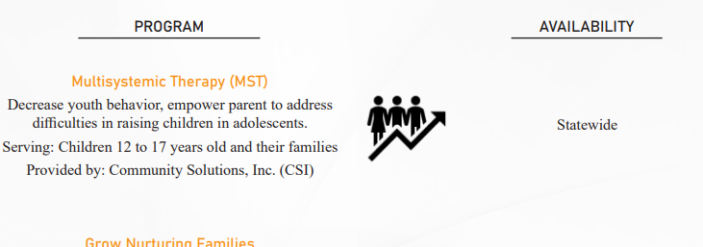
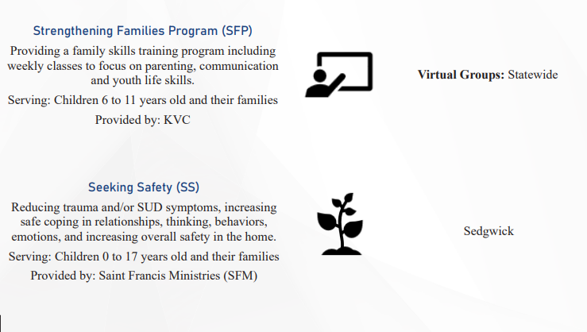
16
Notes:
elisa

Slide 17
Team Decision Making (TDMs)
Team Decision Making (TDM) is a meeting with parents, family, community members and others to actively participate in problem solving and decisions about where children can safely live.
A child may be determined unsafe when danger (serious harm from maltreatment) is present, or the threat of serious harm to the child is imminent (will occur without delay unless there is prompt intervention), and efforts to ensure the safety of the child through development of an Immediate Safety Plan alongside the safety network and the parent/caregiver(s) has been unsuccessful. The CPS Specialist and PPS Supervisor shall consider whether criteria are met requiring a Team Decision Making (TDM) meeting
Notes:
Kristin

Slide 18
Team Decision Making (TDM’S)
July 2025- Dec 2025: Wichita Region held 67 TDMs, which affected 258 children
Approximately 59% of TDMs ended with a recommendation of children returning to family without court involvement
Notes:
KRISTIN
“A Team Decision Making meeting or TDM Meeting is a tool designed to increase agency transparency with families when DCF has safety concerns and is considering separating a child from their parent or caregiver. Families and their entire support network are invited to these meetings and are given the opportunity to be active participants in making the safest, least restrictive placement decision alongside DCF staff and other community partners”
A TDM is NOT intended to prevent foster care, rather they are intended to help create a lasting safety plan by exploring services and all support options, and to ensure that all efforts are made to explore natural supports when separation is unavoidable.”

Slide 19
Family Finding
Family Finding is built on four core beliefs:
Every young person has an immediate and extended family, and they can be found if we try.
Loneliness can be devastating, even dangerous, and is experienced by most children and youth in the care system.
A permanent, meaningful connection to family and caring adults help a youth to develop a sense of belonging and hope.
The single factor most closely associated with positive outcomes for young people is a meaningful, life-long connection to a family and community of support.
Notes:
Kristin
THE OTHER EVIDENCE BASED MODEL I WANT SHARE ABOUT IS Family finding
This slide speaks for itself. We believe that every youth has family, and we will find them.
If a child ends up in foster care they become lonely and that is devastating to the child.
Youth need to feel a sense of belonging. A meaningful, life-long connection to family and community is closely associated with positive outcomes.
This core belief impacts everything DCF does for our families.

Slide 20
Independent Living
The Independent Living (IL) Program in Kansas provides services and supports to youth in foster care as they transition into independence. Services and supports are available to youth upon request and may include:
Locating safe/stable housing
Obtaining a GED or high school diploma
Career and post-secondary education planning
Maintaining employment
Accessing community resources
Budgeting and money management
Notes:
Kristin

Slide 21

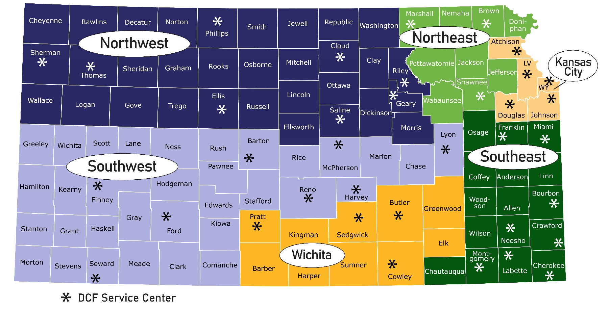
DCF REGIONAL MAP
Northeast Region – Topeka: 785-296-2500
Southeast Region – Chanute: 620-431-5000
Kansas City Region – KC: 913-279-2700
Northwest Region – Manhattan: 785-776-4011
Southwest Region – Garden City: 620-272-5800
Wichita Region – Wichita: 316-337-7000
Notes:
Kristin
Wrap up

Slide 22
Helpful Contacts
Crossover Youth Facilitator (DCF/JIAC) – Elisa Thompson
Foster Care Administrator – Kristin Peterman
Regional Director – Dee Nighswonger
Assistant Regional Director – Elizabeth Gregg
Program Administrator – Vallie Tracy
Program Administrator – Stephanie Uhlik

Slide 23
QUESTIONS?

